Slide 1

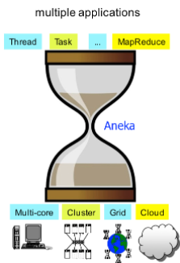
Unit VI – Aneka: Cloud Application Platform
Manjrasoft Pty Ltd is an innovative provider of choice for application acceleration services and solutions over Cloud. Manjrasoft was founded in early 2008 by Dr. Rajkumar Buyya, is a globally recognized thought leader in the field of Distributed, Grid and Cloud Computing.
Aneka plays the role of Application Platform as a Service for Cloud Computing. Aneka supports various programming models involving Task Programming, Thread Programming and MapReduce Programming and tools for rapid creation of applications and their seamless deployment on private or public Clouds to distribute applications.
Cloud Computing
Mr. Vijay Kolte

Slide 2
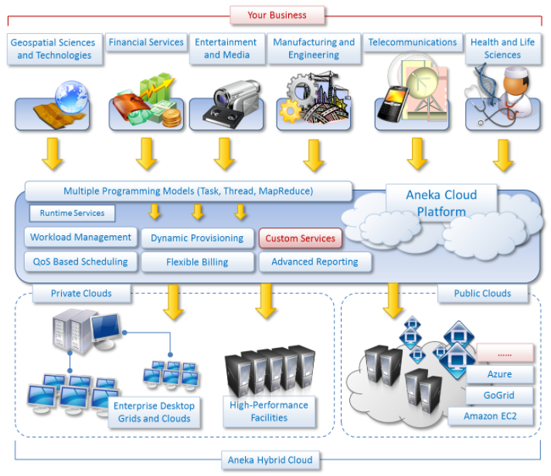
Unit VI – Aneka: Cloud Application Platform
Notes:
One of the notable characteristics of Aneka PaaS is to support provisioning of private cloud resources ranging from desktops, clusters to virtual datacenters using VMWare, Citrix Zen server and public cloud resources such as Windows Azure, Amazon EC2, and GoGrid Cloud Service.
Highlights of Aneka
Technical Value
Business Value

Slide 3
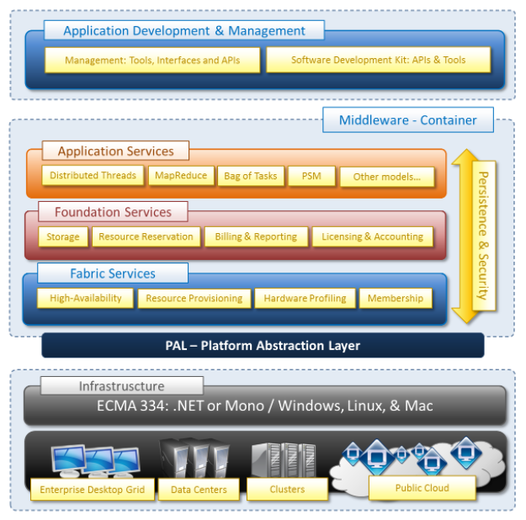
Unit VI – Aneka: Cloud Application Platform
Aneka Architecture
Aneka is a platform and a framework for developing distributed applications on the Cloud.
Aneka provides developers with a rich set of APIs for transparently exploiting such resources and expressing the business logic of applications by using the preferred programming abstractions.
System administrators can leverage on a collection of tools to monitor and control the deployed infrastructure.
Notes:
The Aneka based computing cloud is a collection of physical and virtualized resources connected through a network, which are either the Internet or a private intranet.
Each of these resources hosts an instance of the Aneka Container representing the runtime environment where the distributed applications are executed.
The container provides the basic management features of the single node and leverages all the other operations on the services that it is hosting.
The services are broken up into fabric, foundation, and execution services.
Fabric services directly interact with the node through the Platform Abstraction Layer (PAL) and perform hardware profiling and dynamic resource provisioning.
Foundation services identify the core system of the Aneka middleware, providing a set of basic features to enable Aneka containers to perform specialized and specific sets of tasks.
Execution services directly deal with the scheduling and execution of applications in the Cloud.

Slide 4
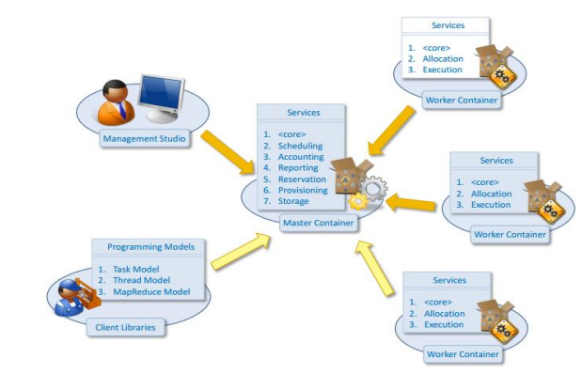
Unit VI – Aneka: Cloud Application Platform

Slide 5
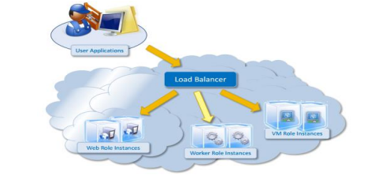
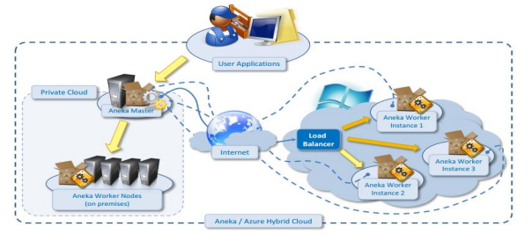
Unit VI – Aneka: Cloud Application Platform
Notes:
A role on Windows Azure refers to a discrete scalable component built with managed code. Windows Azure currently supports three kinds of roles.
Web Role: a Web role is a role that is customized for Web application programming as is supported by IIS 7.
Worker Role: a worker role is a role that is useful for generalized development. It is designed to run a variety of Windows-based code.
VM Role: a virtual machine role is a role that runs a user-provided Windows. Server 2008 R2 image.
A Windows Azure service must include at least one role of either type, but may consist of any number of Web roles, worker roles and VM roles. Furthermore, we can launch any number of instances of a particular role. Each instance will be run in an independent VM and share the same binary code and configuration file of the role.

Slide 6
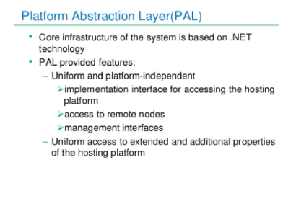
Unit VI – Aneka: Cloud Application Platform

Slide 7
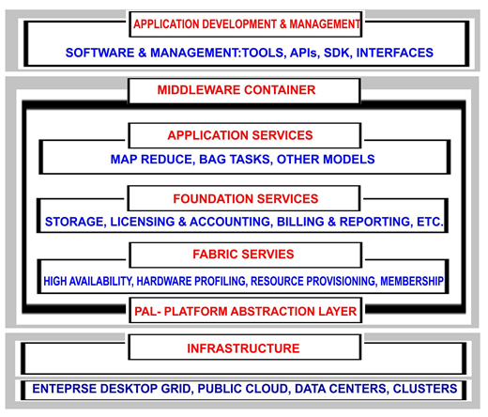

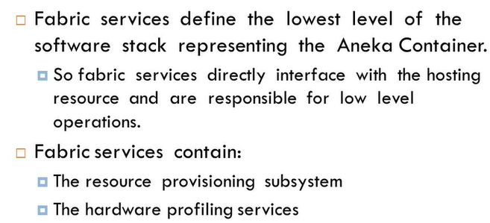
Unit VI – Aneka: Cloud Application Platform

Slide 8
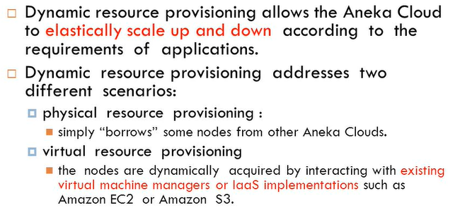
Unit VI – Aneka: Cloud Application Platform

Slide 9
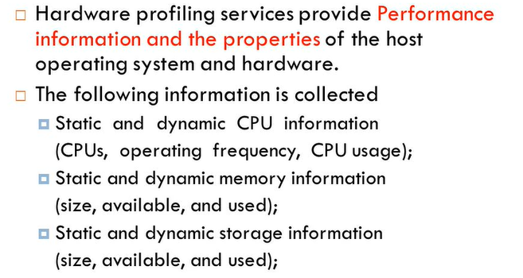
Unit VI – Aneka: Cloud Application Platform

Slide 10

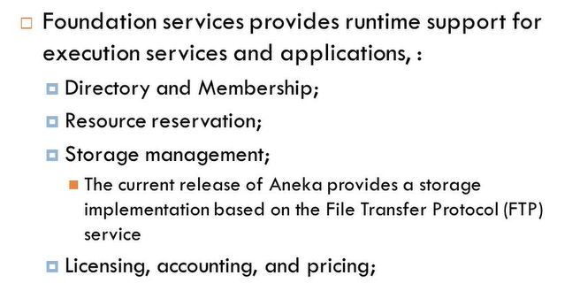
Unit VI – Aneka: Cloud Application Platform
Notes:
Foundation services
Foundation services identify the core system of the Aneka middleware, providing a set of basic features to enable Aneka containers to perform specialized and specific sets of tasks. Execution services directly deal with the scheduling and execution of applications in the Cloud.
Storage management
Aneka offers two different facilities for storage management: a centralized file storage, which is mostly used for the execution of compute-intensive applications, and a distributed file system, which is more suitable for the execution of data-intensive applications.

Slide 11
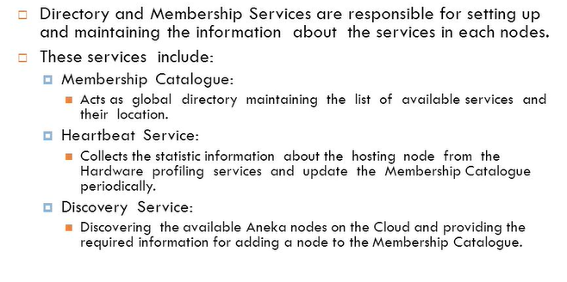
Unit VI – Aneka: Cloud Application Platform

Slide 12
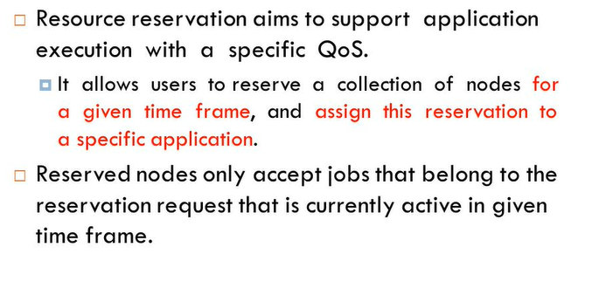
Unit VI – Aneka: Cloud Application Platform

Slide 13
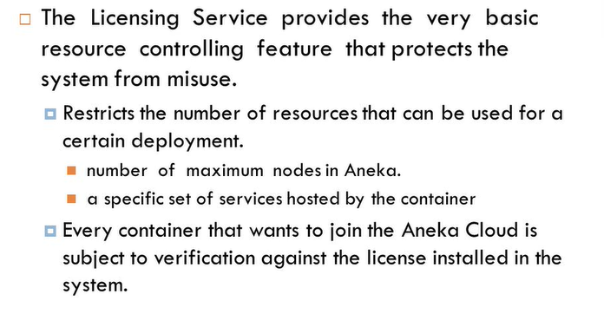
Unit VI – Aneka: Cloud Application Platform

Slide 14

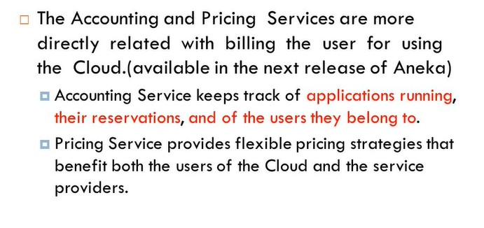
Unit VI – Aneka: Cloud Application Platform

Slide 15

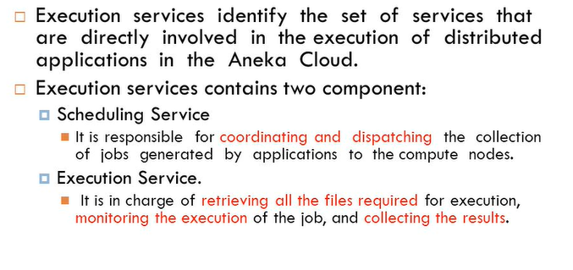
Unit VI – Aneka: Cloud Application Platform

Slide 16


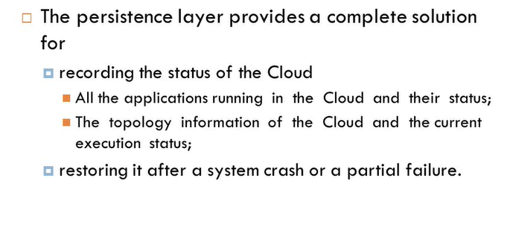
Unit VI – Aneka: Cloud Application Platform

Slide 17

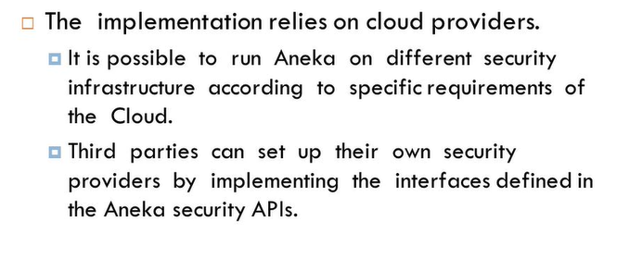
Unit VI – Aneka: Cloud Application Platform

Slide 18
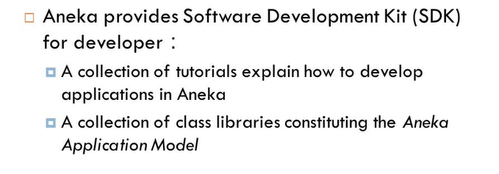
Unit VI – Aneka: Cloud Application Platform

Slide 19
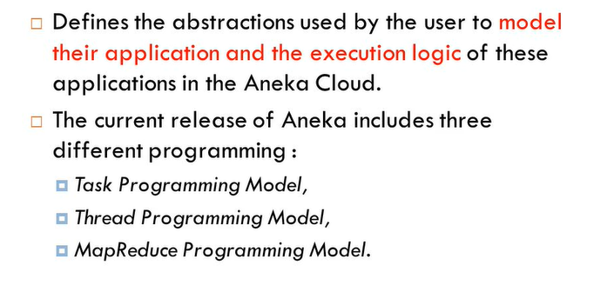
Unit VI – Aneka: Cloud Application Platform

Slide 20
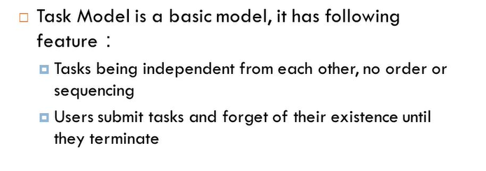
Unit VI – Aneka: Cloud Application Platform

Slide 21
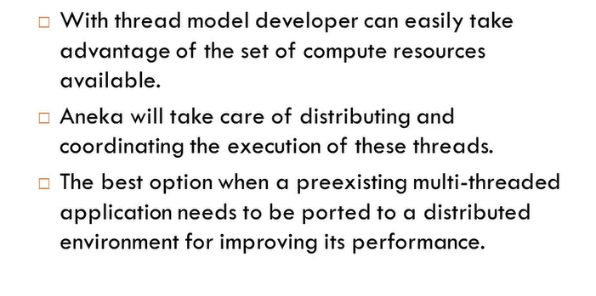
Unit VI – Aneka: Cloud Application Platform

Slide 22
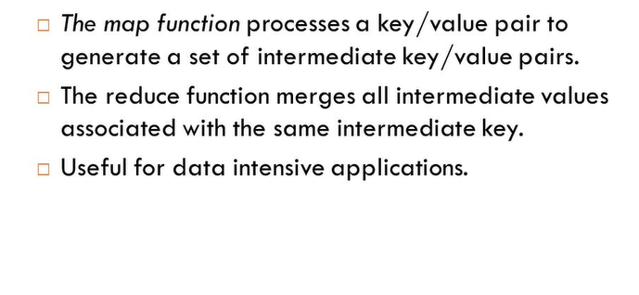
Unit VI – Aneka: Cloud Application Platform

Slide 23
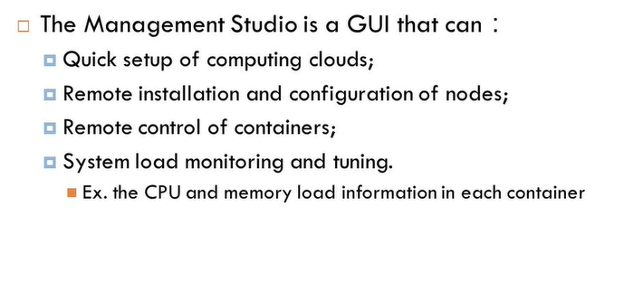
Unit VI – Aneka: Cloud Application Platform

